Slide 1
Image Processing System Architecture using AWS Cloud

Slide 2


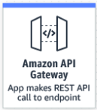
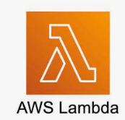





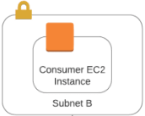

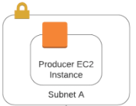






System Architecture Deign to Progress Images and Provide Image Statistics on Dashboard
Lambda is triggered
Create object
AWS Glue Crawler
Front-end code for app is hosted in S3
User upload image on web app
Lifecycle rule is configured to delete objects older than 7 days from S3
Create object
AWS AMK
AWS Lambda
AWS Kinesis Data Firehose

Slide 3
Web Application Which Collects Images Uploaded by Customers
Here the Web Application is hosted in S3 and when user upload images via web app Rest API call the Lambda which stores the images into S3
S3 bucket is configured to delete the images older than 7 day by using lifecycle policy rule
If required S3 glacier can used to save some cost, However the retention period is only 7 days hence not considered in current design
Lambda is triggered
Create object
Front-end code for app is hosted in S3
User upload image on web app
Lifecycle rule is configured to delete objects older than 7 days from S3

Slide 4
Web Application Which Provides A Stream of Images Using a Kafka Stream
Here the Web Application hosted in EC2 instance in 2 subnet for high availability which produces stream to AWS managed apache kafka
AWS Lambda consumes the images from kafka and send it to Kinesis Data Firehose. Kinesis Data Firehose write it into S3
S3 bucket is configured to delete the images older than 7 day by using lifecycle policy rule
If required S3 glacier can used to same some cost, However the retention period is only 7 days hence not considered in current design
Create object
Lifecycle rule is configured to delete objects older than 7 days from S3
AWS AMK
AWS Lambda
AWS Kinesis Data Firehose

Slide 5
Image statistics
AWS Glue, Athena is used to scan the schema and create the metadata
QuickSight access Athena to read the image statistics
Required dashboard prepared at QuickSight
User access QuickSight based on Role and see the required dashboard
S3
AWS Glue Crawler

Slide 6
Assumption
All the security rules are in same policy group with required inbound and outbound port

Slide 7
PROS and CONS
PROS
Cost Effective Pay as we go Not required to manage resources (except EC2 instance in design) Application setup and configuration can be done in quick time Easy to scale
CONS
Cloud computing glitches Overuse of the services due to the ease of access Images are stored into AWS datacentre Bill Shock Once started using, Difficult to moving out from AWS/Cloud

Slide 8
Improvement
Based on the requirement, cost and budget, multi region architecture can be used for high availability

